Slide 2


Welcome To:
Letterkenny
It is a free, one-day, hands-on training event led by Microsoft MVPs with support from Microsoft and local community leaders.
Developers worldwide are invited to attend the bootcamp to learn the latest on Microsoft /Azure AI Platform including Azure Bot Services, Azure Cognitive Services and Azure Machine Learning and apply what you learn to your future projects.
Letterkenny Microsoft User Group(LK-MUG) & Pramerica brings you this event in Letterkenny.

Slide 3

Thank you all for joining us
You learning something new today and keep practicing.

Slide 4
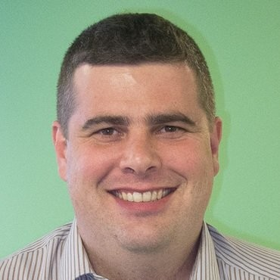
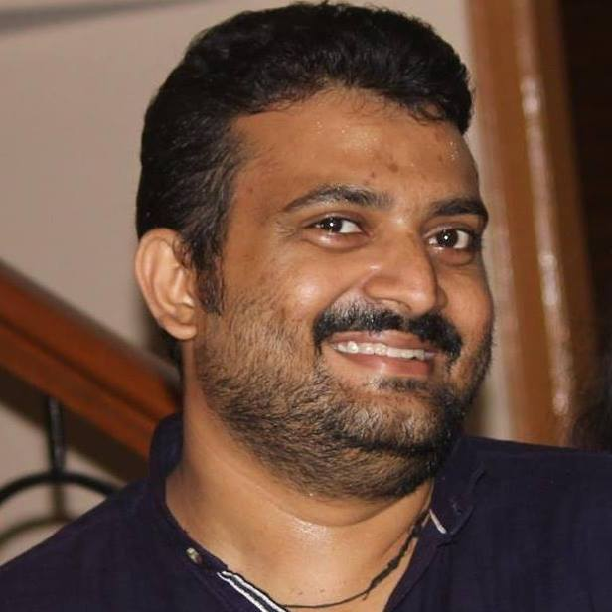
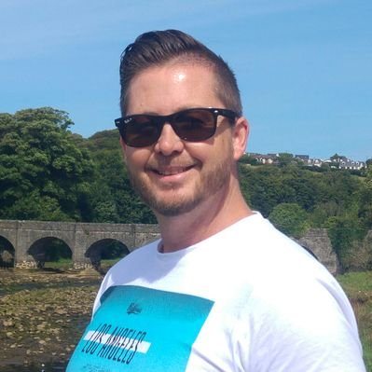
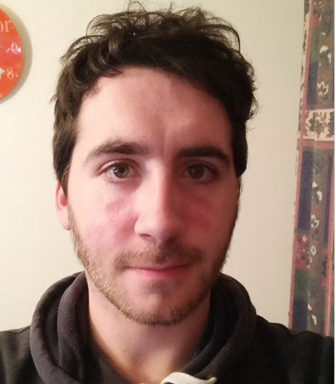
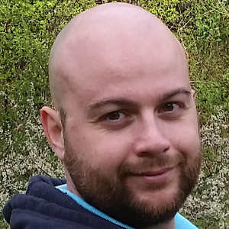


A Big Thanks To All Speakers
Letterkenny
Joon Du Rant
Nithin Mohan
Richard Fisher
Owen Lyons
Velin Georgiev

Slide 5
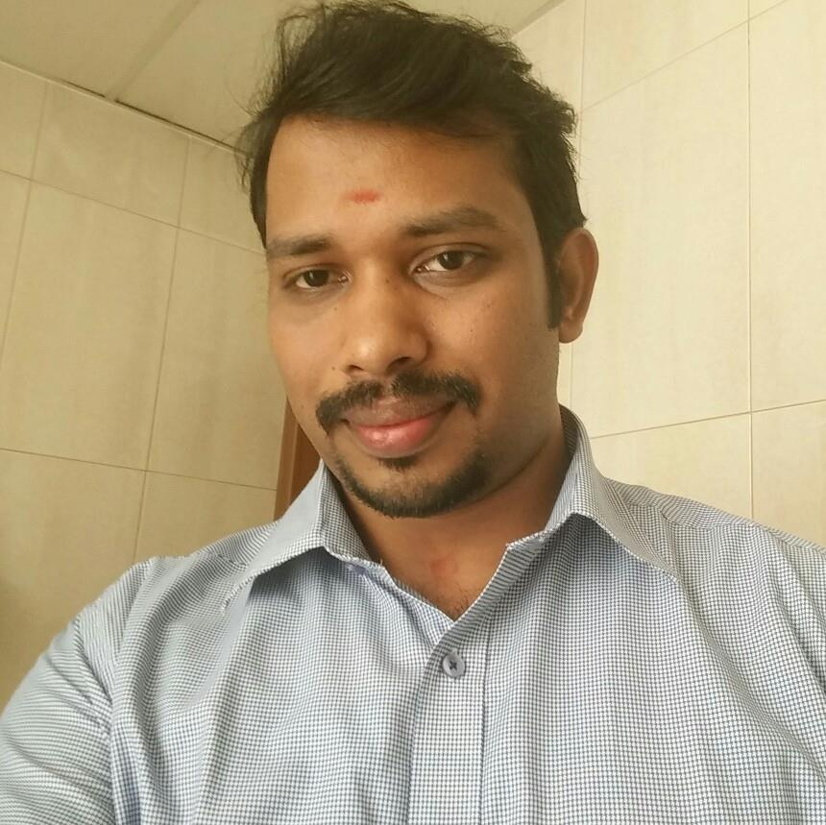

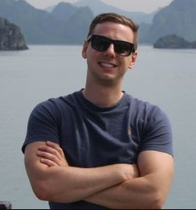
#Organizers
LKMUG #Core #Team
Nithin Mohan
Sibin Sygal
Velin Georgiev
Joon Du Rant
Ray Hogan
Richard Fisher

Slide 6

#Supporters /Mentors
Ryan Callaghan (Pramerica) - AV

Slide 7
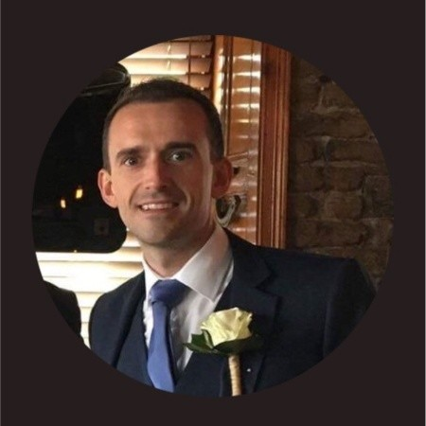


#Special #Thanks
Helping us to make it possible
Pramerica
Leadership Team
Facilities & Catering
Securities
Communications
Support Staffs
Joseph Dunleavy
VP , Head of Innovation
Pramerica

Slide 8

#GlobalAIBootcampLK
Lets have some swag…

Slide 9






Letterkenny
Date: Saturday, 15th Dec Time: 9:00AM – 5:30PM
Sponsors:
Venue & Refreshments
RAFFLE for one, 1 year license
RAFFLE for one, 1 year license
Swags & Refreshments
Event theme, TShirts and lunch.

Slide 10
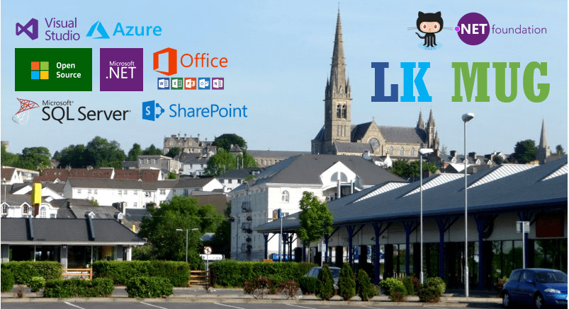
LK-MUG
LK Community is for everyone interested in Microsoft .NET, Office-365, SharePoint, Azure cloud platform and other Microsoft Open Source initiatives.
Letterkenny
.MUG
We are a Microsoft recognized user group established in Letterkenny, work under the umbrella of .NET foundation.
All skill levels are welcome.
We are committed to helping you learn and share things about .NET, Office-365, SharePoint and Azure Cloud.
Our community brings all students, enthusiasts, experts and professionals working in and around Letterkenny/Donegal.
Time to time you will be seeing events organized by Microsoft and MVPs to provide best-in-class learning experience for Microsoft Technology enthusiasts.
Attention!
Looking for local speakers to future UG sessions in Letterkenny. If you are interested to take up any sessions, please email
lk-mug@outlook.com
Letterkenny DotNet Azure User Group (Letterkenny Microsoft User Group)
- An ultimate Microsoft developer and IT Pro community for Donegal.
Letterkenny, Donegal, Ireland

Slide 11

Upcoming Events
“ Think of the Talking Tech Edge as your technology scout, bringing to you
regular updates on the latest advances from tech industry, individuals, and academia worldwide in a short,
quickly digestible form that will serve to both inform and inspire our next gen of speakers.”
A series of Technical webinars
A platform for new speakers in the community.
You can join from any where.
You are the speaker.
You decide your topic.
We will support you.
First Episode(2018/19) is scheduled to start on November’27th. - .NET Conf – Introduction to .NET Core 2.1

Slide 12
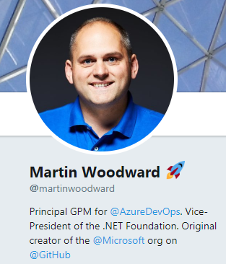
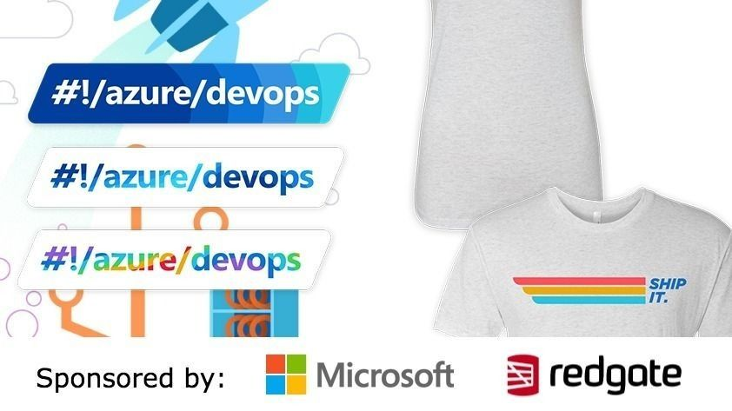

Upcoming Events
Azure DevOps Community Launch - Letterkenny - 8' January 2019
DevCon #Letterkenny
February 23, 2019
Location: LYIT
Global Azure Bootcamp 2019 – April 27th

Slide 13


Join Us Website: http://www.lk-mug.org Meet up Url: https://www.meetup.com/lk-mug/ Twitter: https://www.twitter.com/lkmsug Facebook: https://www.facebook.com/lkmsug Hashtag: #lkmug
Join Our Other Meetups
ThingX-LY IoT Meetup
https://www.meetup.com/thingx-ly
LetterkennyJS (Javascript Meetup)
https://www.meetup.com/letterkennyjs

